Slide 1
Reading:
Titus (ਤੀਤੁਸ) 2:6
Proverbs (ਕਹਾਉਤਾਂ) 1:7-19

Slide 2
What changes do teenagers undergo during Puberty
Physical changes
Emotional and Psychological changes
Cognitive, mental changes

Slide 3
What are the challenges and dangers Puberty
Peer Pressure
Body image issues
Technology addiction
Mental health problems

Slide 4
2. Wisdom for Young People
Young people are to be “sober-minded” or “self controlled” Titus 2:6. How can they do this?
Fear the Lord (Proverbs 1:7)
Obey Parents (Proverbs 1:8-9)
Do not keep bad company (Proverbs 1:8-19)
Keep away from immorality and keep yourself sexually pure (Proverbs 5-7)

Slide 5
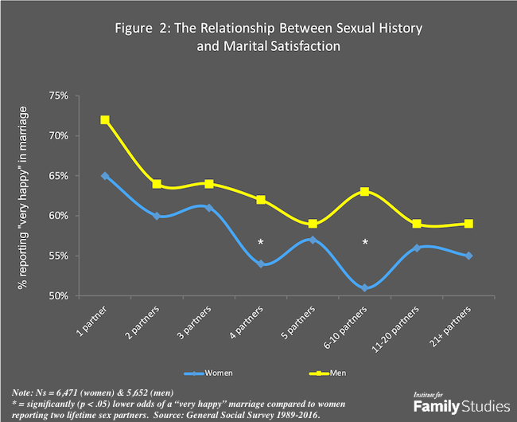

Slide 6
2. Wisdom for Young People
Young people are to be “sober-minded” or “self controlled” Titus 2:6. How can they do this?
Fear the Lord (Proverbs 1:7)
Obey Parents (Proverbs 1:8-9)
Do not keep bad company (Proverbs 1:8-19)
Keep away from immorality and keep yourself sexually pure (Proverbs 5-7)
Make Christ your role model (Romans 8:29, 1 Cor 11:1)

