Slide 1
Reading:
Exodus 3:1-11

Slide 2
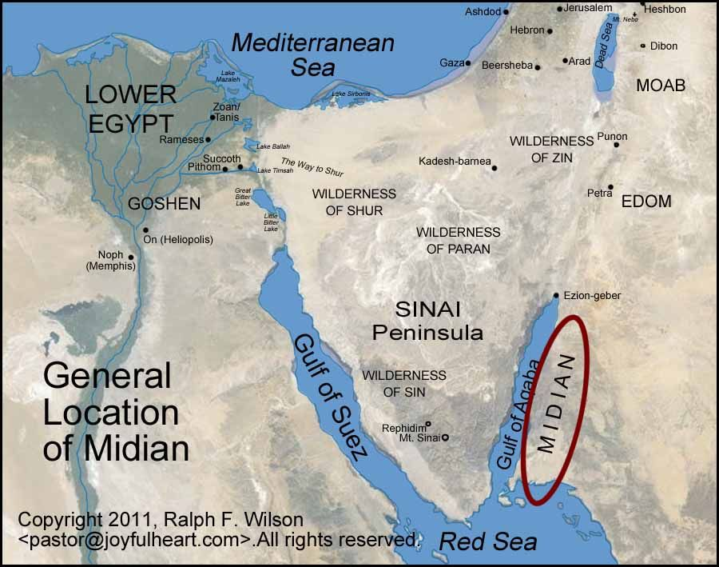

Slide 4
God who reveals Himself to his people
God who knows the needs of his people
God who breaks in to save his people
God who prepares His people for the task
The God of the Burning Bush

