Slide 1
Bible Reading
(Exodus 31:1-11 & Hebrews 9:1-10)

Slide 2
Remainder of Exodus
Exodus 21:1-11 Laws concerning slaves
Exodus 21:12-32 Laws concerning Behaviour
Exodus 21:33 – 22:15 Laws concerning restitution
Exodus 23:10-19 Ceremonial laws including the celebration of feasts
Exodus Instructions concerning the tabernacle
Exodus 25–31 God’s instructions to Moses on Mount Sinai for building the Tabernacle,
Exodus 35–40 The actual building of the Tabernacle, following the instructions God gave. Includes the collection of materials, construction, and assembly.
Exodus 40:17–33 Final erection of the Tabernacle and completion of the work.
Exodus 40:34–38 God’s glory fills the Tabernacle — His presence comes to dwell with His people.

Slide 3
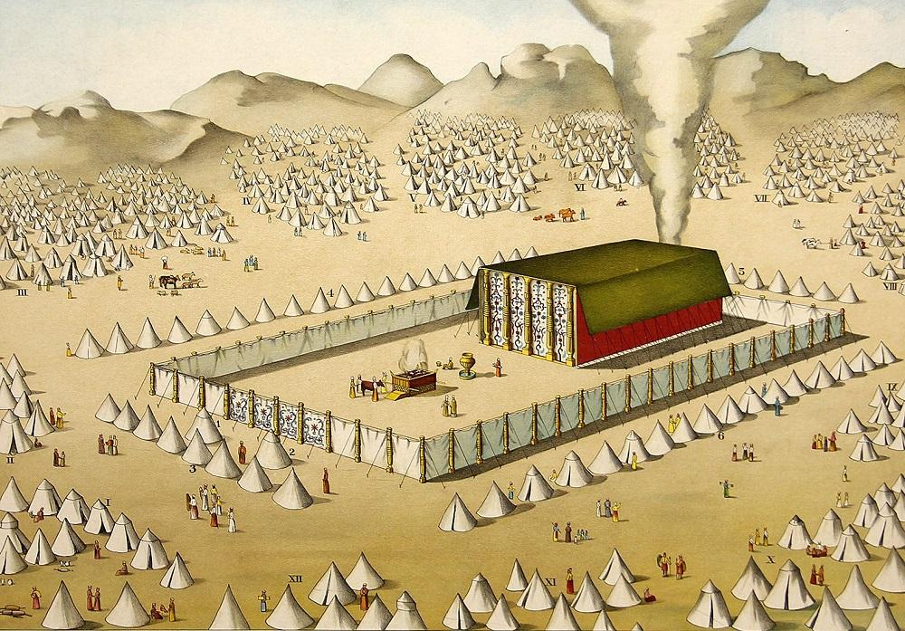
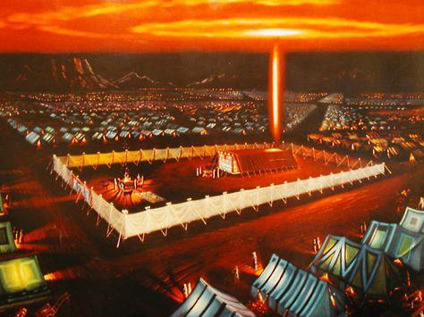
The Tabernacle of God
(Exodus 25-31 & 35-41)

Slide 4
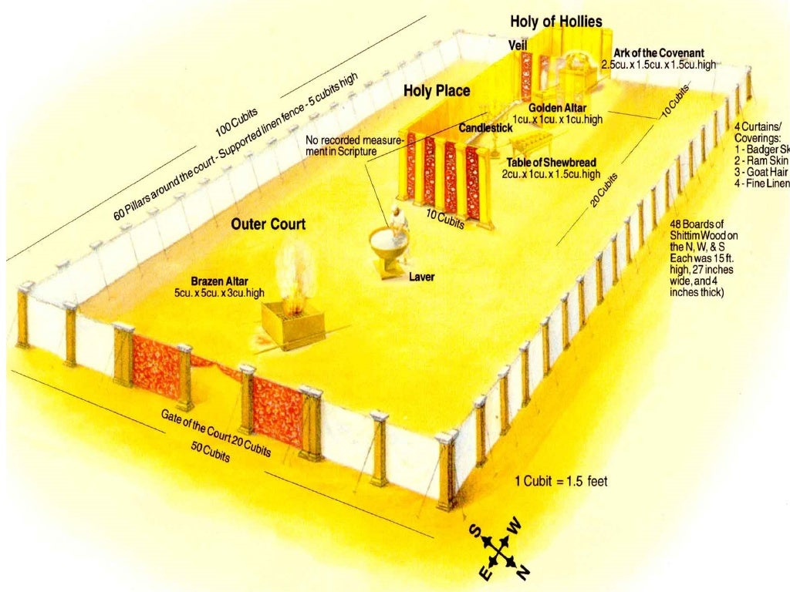
The Tabernacle as a whole

Slide 5
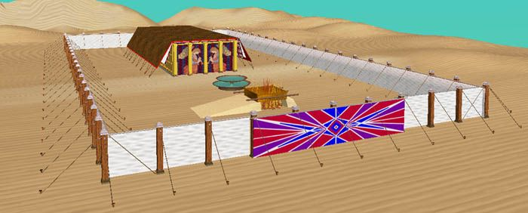
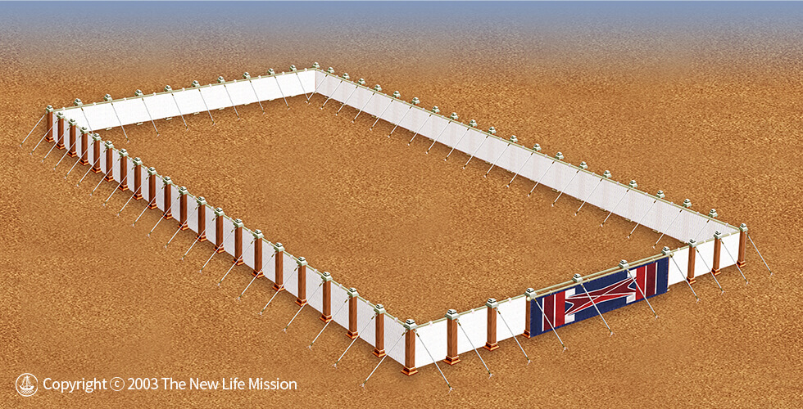
1. The Courtyard and entrance (Exodus 25-27)

Slide 7
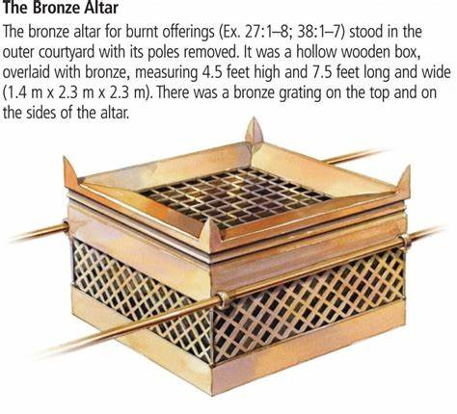
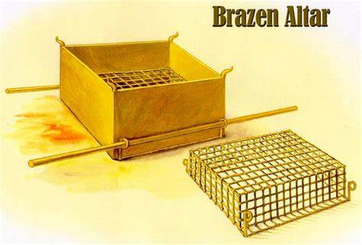
2. The Brazen Altar
(Exodus 27:1-8 & 38:1-7)

Slide 9
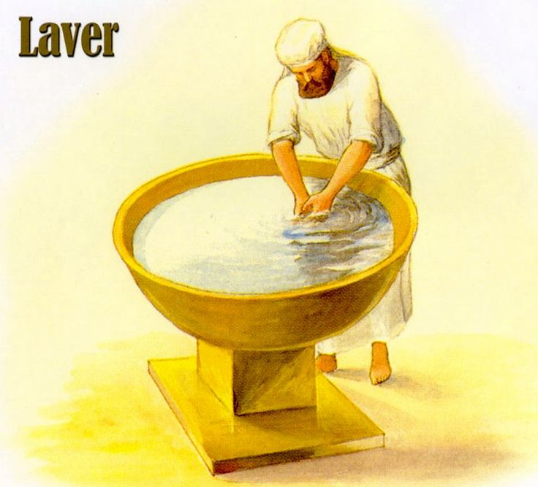
3. The Laver
Exodus 30:17–21

Slide 12
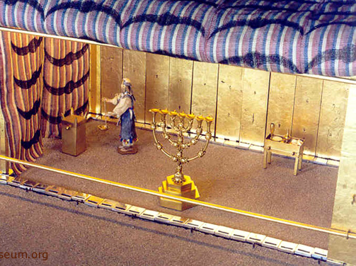
4. The Holy place
Exodus 26:33

Slide 13
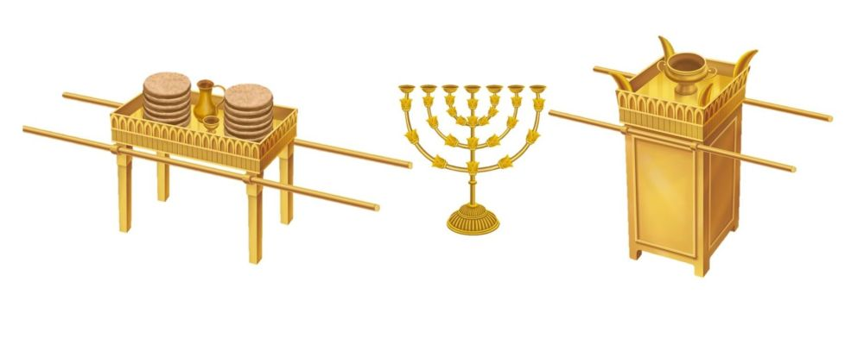
The Lampstand
Exodus 25:31-40
The Table of Showbread
Exodus 25:23-30
The golden altar of incense
Exodus 30:1-10

Slide 15
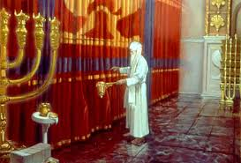
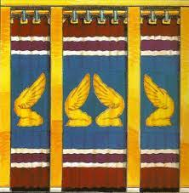
5. The Veil
Exodus 26:31–33

Slide 16
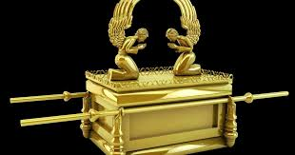
6. The Holy of Holies
The ark of the covenant
Exodus 25:10–22

Slide 17
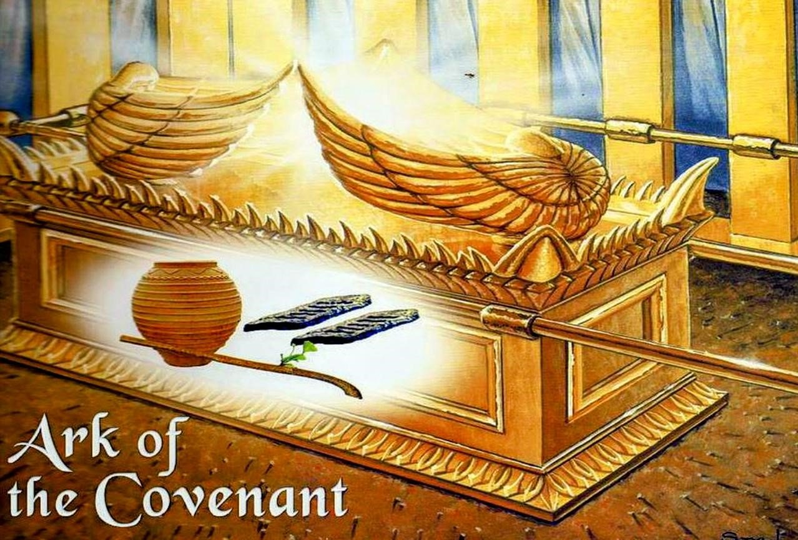

Slide 18
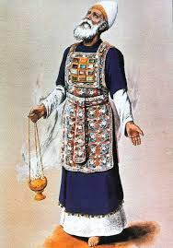
7. The High Priest
Exodus 28-29

Slide 20
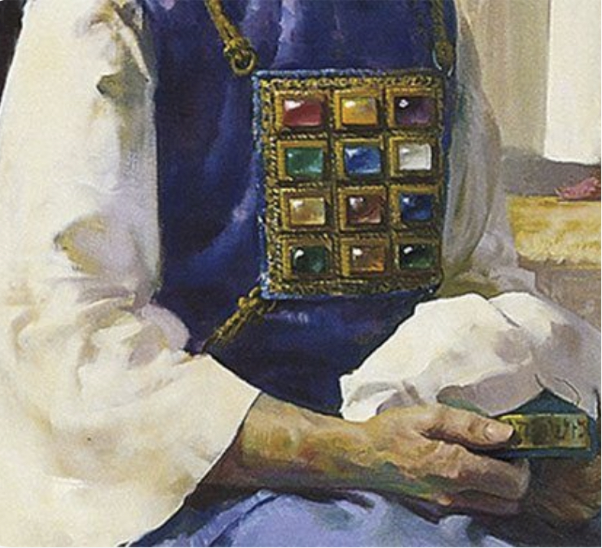
The High Priest’s
breastplate

Slide 21
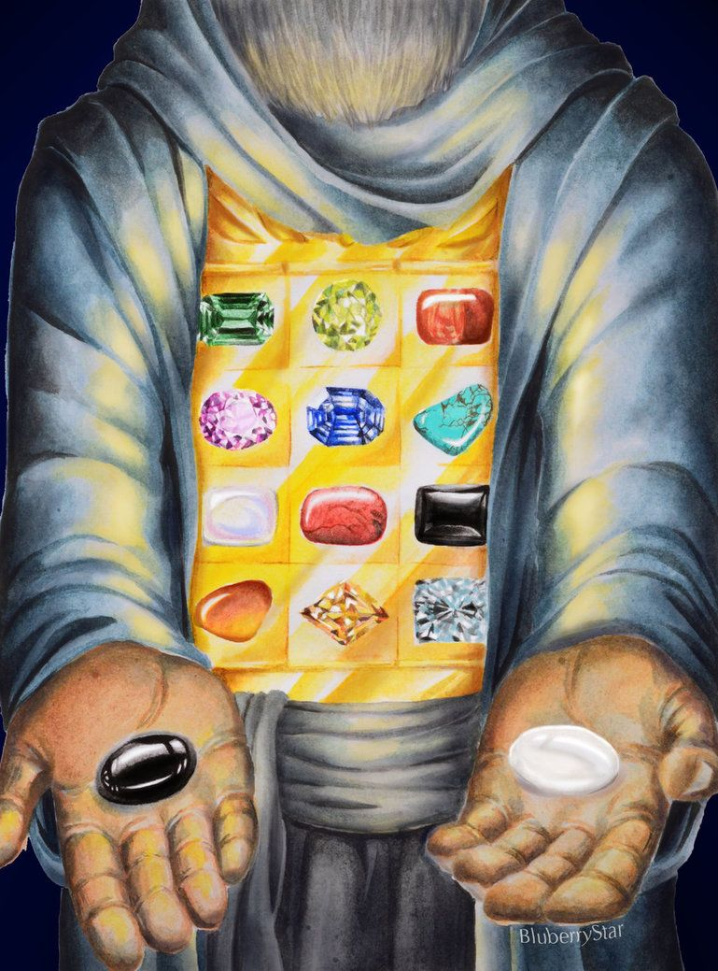
Urim and Thummim

Slide 22
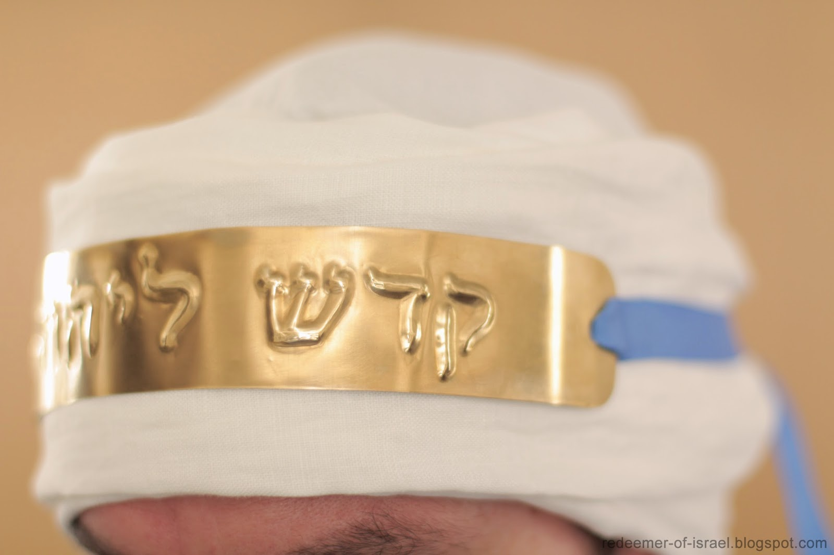
The High Priest’s head covering

Slide 23
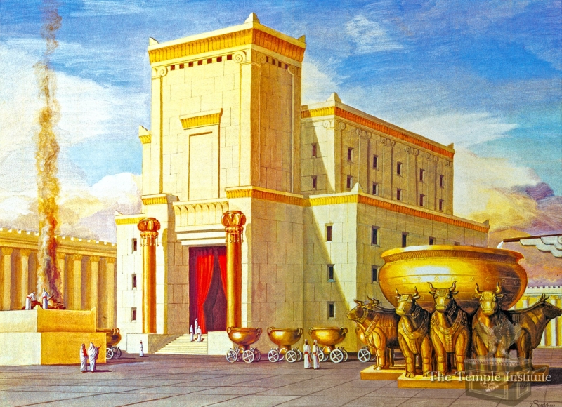
The veil in the temple torn
Matthew 27:50-51

Slide 24
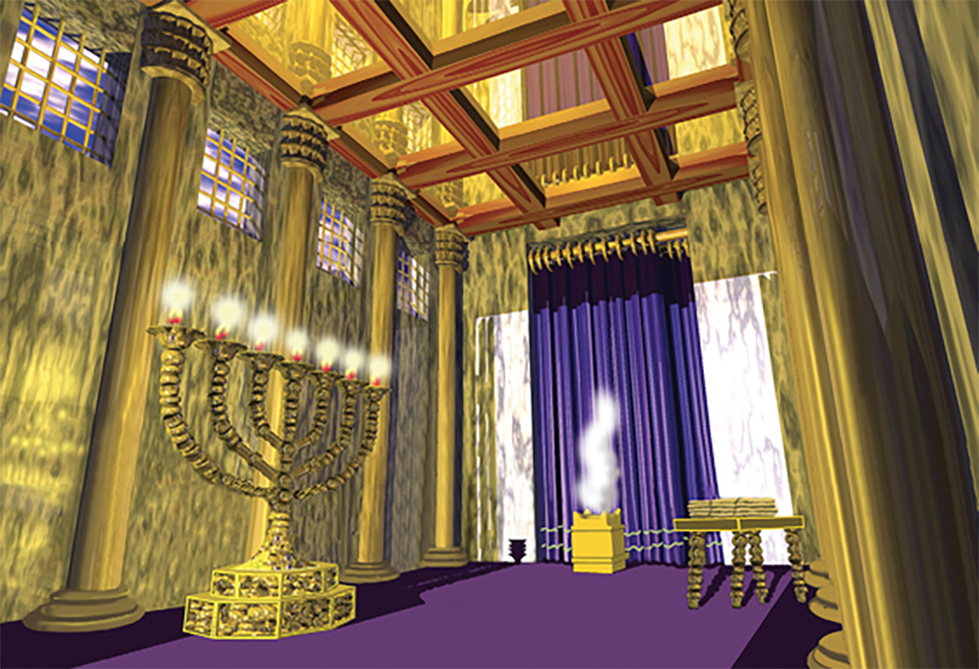

Slide 25
